Slide 1



Searching for signs of resilience in over-wintering juvenile pteropods to ocean acidification and deoxygenation
Shelly Trigg, Ph.D.
School of Aquatic and Fishery Sciences
University of Washington
NOAA Collaborators:
Krista Nichols, Shallin Busch, Paul McElhany,
Michael Maher, Danielle Perez, Caitlin O’Brien
NWFSC Montlake and Mukilteo Research Station,
Conservation Biology Division, Genetics Section
Notes:
Hi everyone, I’m Shelly Trigg and I am a postdoc in Steven Roberts lab at UW. I’m going to be talking about an on-going collaboration with Krista Nichols, Shallin Busch, and Paul McElhany on how pteropods respond to ocean acidification and low oxygen through the molecular lens. I’d like to take a second to acknowledge all the co-authors for carrying out the experiment and helping with analyses making this collaboration a success.

Slide 2
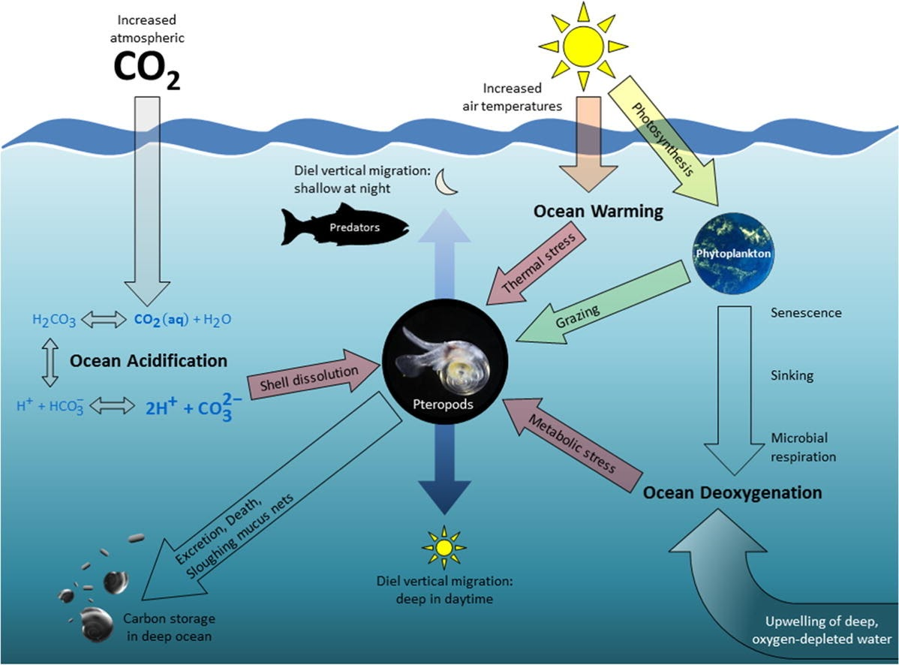
Pteropods are important
Notes:
Pteropods make up a large proportion of plankton and are important in marine food webs and carbon cycling

Slide 3
Pteropods are sensitive to low pH, Ω_{A}
pH = measure of hydrogen ions
Ω_{A} = measure of carbonate ions
Notes:
Pteropods are sensitive to low pH and aragonite but before I talk about those studies, I want to explain the difference between pH and aragonite saturation. pH is a measure of hydrogen ions where aragonite saturation is a measure of carbonate ions. We care about carbonate because Carbonate is a key compound that marine calcifiers use to form their shells

Slide 4
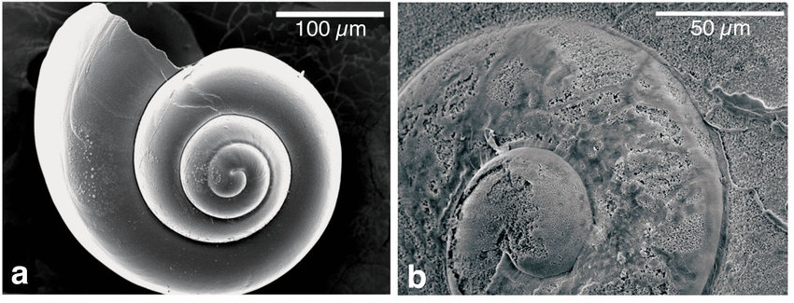
Pteropods are sensitive to low pH, Ω_{A}
pH = measure of hydrogen ions Ω_{A} = measure of carbonate ions
Studies show sensitivity to low Ω_{A}
Field: Lab and Field:
↓ survival ↑ shell dissolution
↓ shell condition
↓ shell growth
Fall and winter Summer
N. Atlantic Antarctic, CA Current
(Lischka et al. 2011)
(Bednaršek et al. 2012; Bednaršek et al. 2014; Busch et al. 2014)
(Lischka and Riebesell 2012)
Notes:
Field and lab studies have shown decreased survival, decreased shell condition, decreased shell growth, and increased shell dissolution when aragonite saturation is low

Slide 5
Puget Sound pteropods show resilience
pH = measure of hydrogen ions Ω_{A} = measure of carbonate ions
Studies show sensitivity to low Ω_{A}
Resilience in the field
Field: Lab and Field:
↓ survival ↑ shell dissolution
↓ shell condition
↓ shell growth
Fall and winter Summer
N. Atlantic Antarctic, CA Current
Puget Sound winter conditions:
Low pH, Ω_{A}
Low food availability
(Lischka et al. 2011)
(Bednaršek et al. 2012; Bednaršek et al. 2014; Busch et al. 2014)
(Lischka and Riebesell 2012)
Notes:
However in Puget Sound where pH aragonite saturation and food availability is low in the winter, the pteropod population continues to persist, indicating they have some resilience.

Slide 6
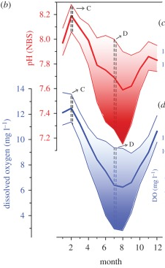
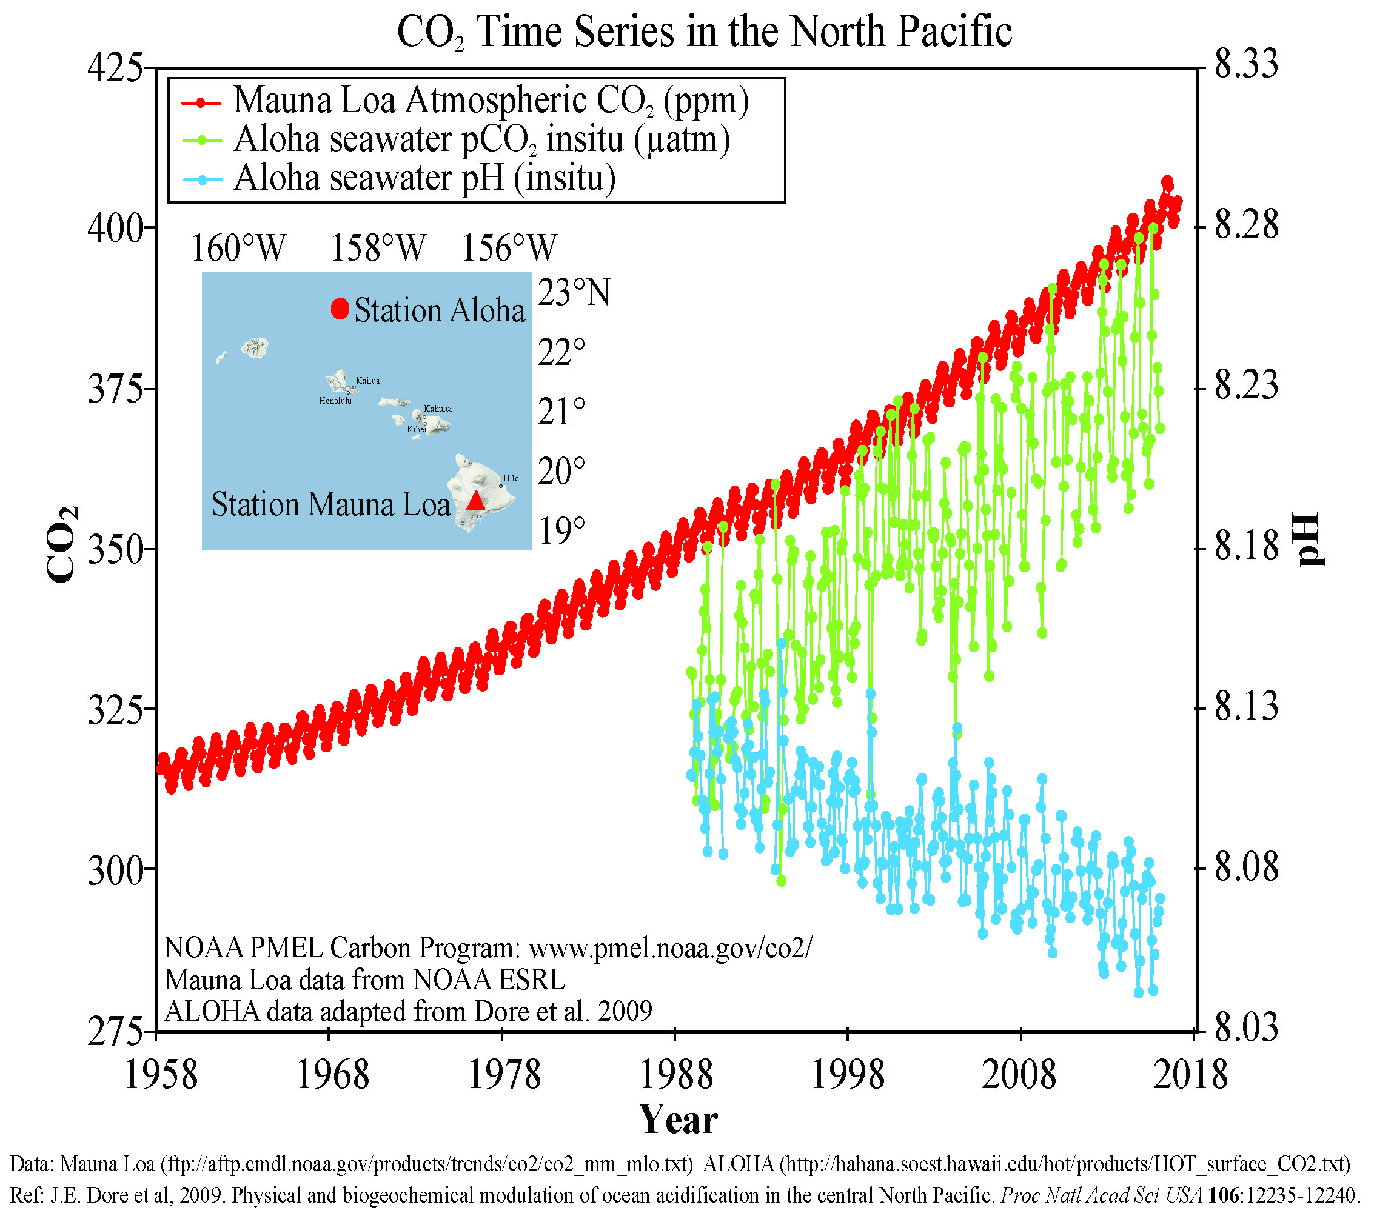
How will ocean change affect Pteropods?
Studies show sensitivity to low Ω_{A}
Resilience in the field
Field: Lab and Field:
↓ survival ↑ shell dissolution
↓ shell condition
↓ shell growth
Fall and winter Summer
N. Atlantic Antarctic, CA Current
Puget Sound winter conditions:
Low pH, Ω_{A}
Low food availability
Atmospheric CO₂ is increasing
Ocean pH is decreasing
Ocean pH and O₂ co-vary
(Lischka et al. 2011)
(Bednaršek et al. 2012; Bednaršek et al. 2014; Busch et al. 2014)
(Lischka and Riebesell 2012)
Bednaršek et al. 2016
Gobler and Baumann (2016) Biology Letters
Notes:
But how will pteropods tolerate the ocean acidification and low oxygen conditions predicted for Puget Sound in the future?

Slide 7
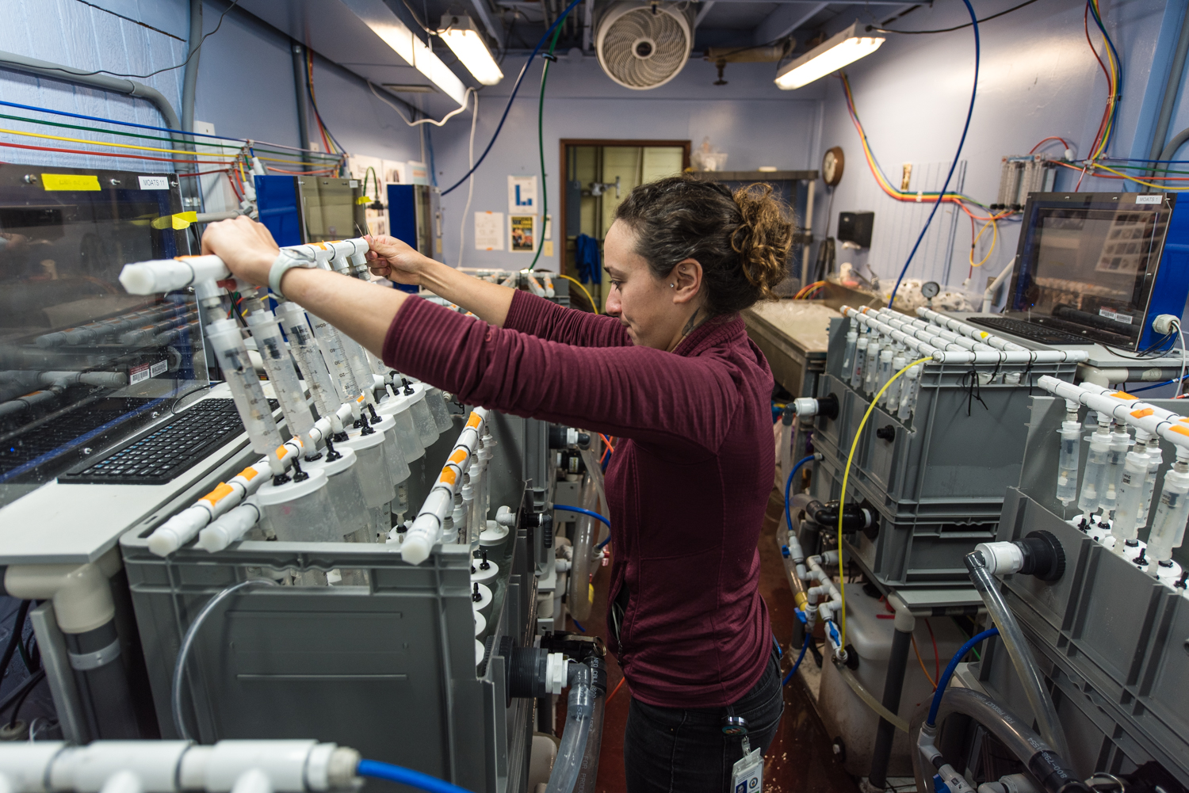
How sensitive are juvenile pteropods (L. helicina) to low O₂ AND pH, Ω_{A} ?
juveniles exposed for 9 days
MOATS
(Mobile ocean acidification treatment systems)
pH, Ω_{A}
Norm pH
Norm O₂
Low pH
100% O₂
pH 7.95, Ω_{A} 1.1
100% O₂
pH 7.55, Ω_{A} 0.5
O₂
Low pH
Low O₂
Low O₂
40% O₂
pH 7.95, Ω_{A} 1.1
40% O₂
pH 7.55, Ω_{A} 0.5
Treatments calibrated to Puget Sound current and projected conditions
Notes:
We performed a two-factor experiment exposing juvenile overwintering pteropods to these 4 conditions for 9 days. These treatments were calibrated to puget sound current and projected conditions. The animals were reared in the MOATS system at Mukilteo that allow for individual rearing and group replication.

Slide 8
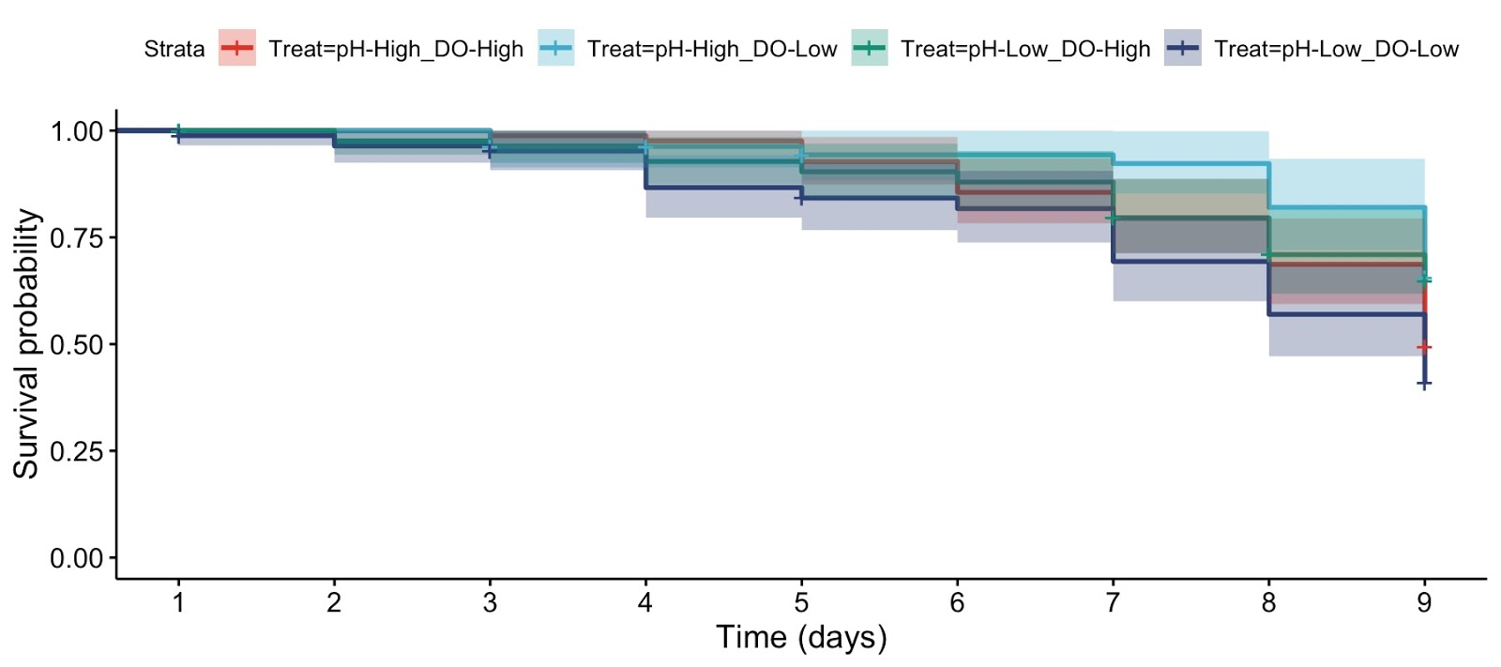
Survival similar across lab altered pH and O₂ conditions
juveniles exposed for 9 days
MOATS
(Mobile ocean acidification treatment systems)
Survival ~ 75% across groups
Kaplan-Meyer survival curves for 4 treatments
pH, Ω_{A}
Norm pH
Norm O₂
Low pH
100% O₂
pH 7.95, Ω_{A} 1.1
100% O₂
pH 7.55, Ω_{A} 0.5
O₂
Low pH
Low O₂
Low O₂
40% O₂
pH 7.95, Ω_{A} 1.1
40% O₂
pH 7.55, Ω_{A} 0.5
Notes:
We found that no group showed higher mortality rate possibly owing to the stress of laboratory rearing. With average survival across groups around 75%.

Slide 9
Survival similar across lab altered pH and O₂ conditions
juveniles exposed for 9 days
MOATS
(Mobile ocean acidification treatment systems)
pH, Ω_{A}
Survival was weakly significantly reduced for Low pH Low O₂
How are pteropods coping physiologically?
Norm pH
Norm O₂
Low pH
100% O₂
pH 7.95, Ω_{A} 1.1
100% O₂
pH 7.55, Ω_{A} 0.5
O₂
Low pH
Low O₂
Low O₂
40% O₂
pH 7.95, Ω_{A} 1.1
40% O₂
pH 7.55, Ω_{A} 0.5

Slide 10
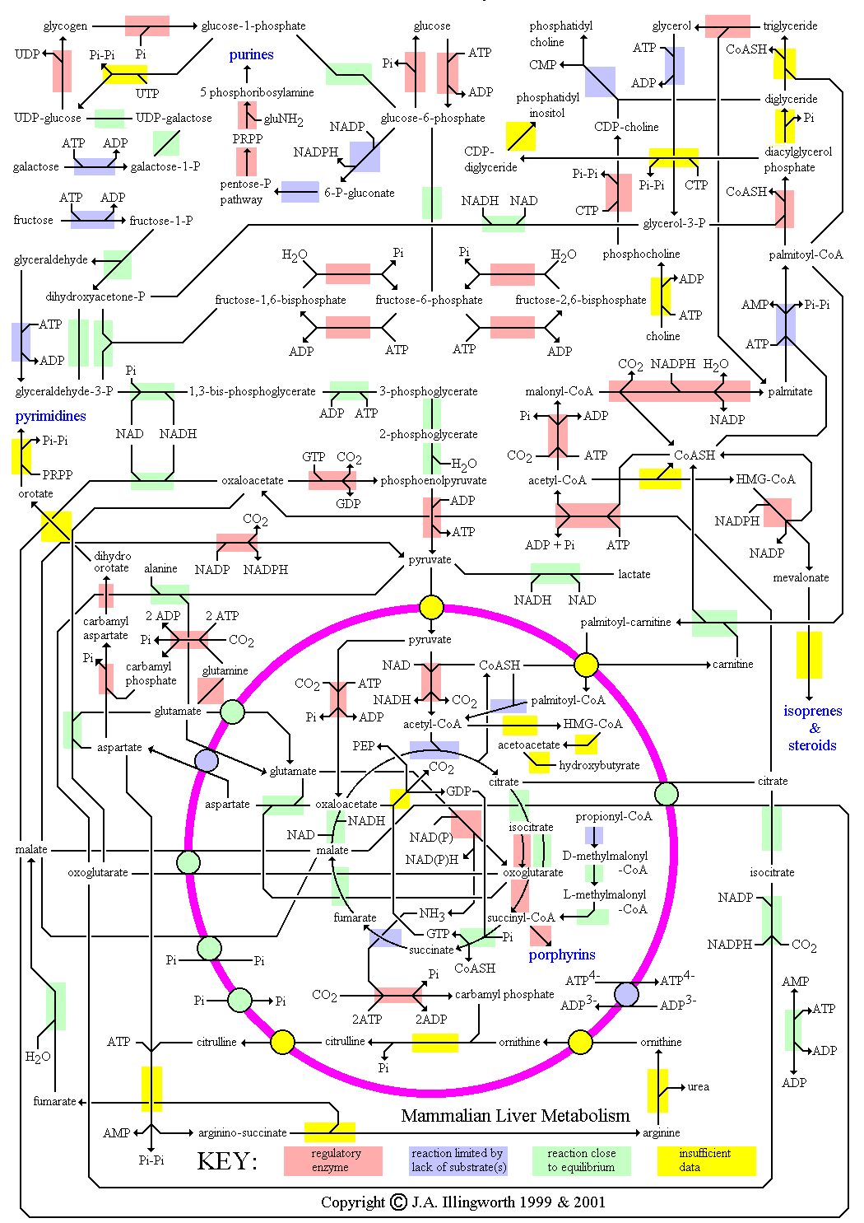
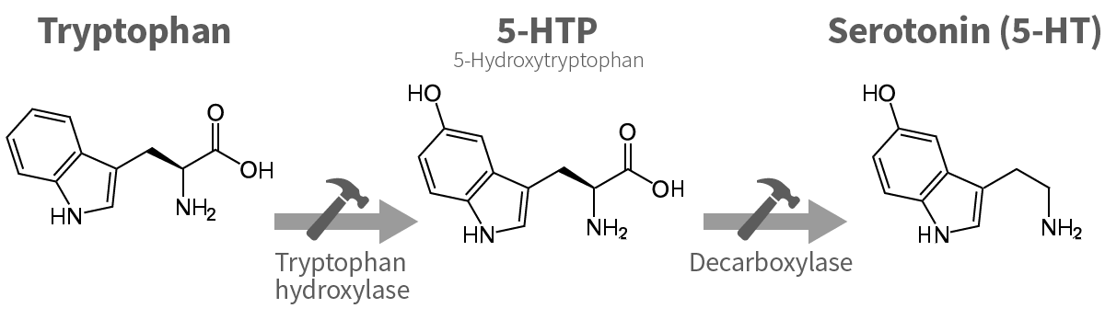
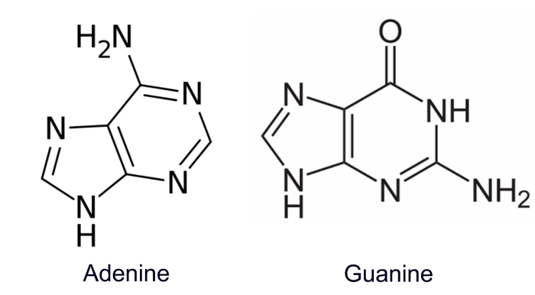
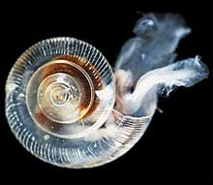
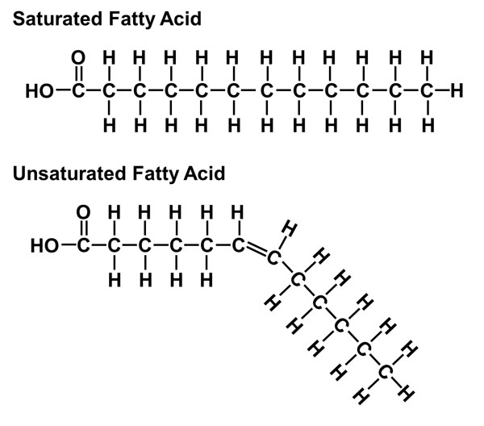
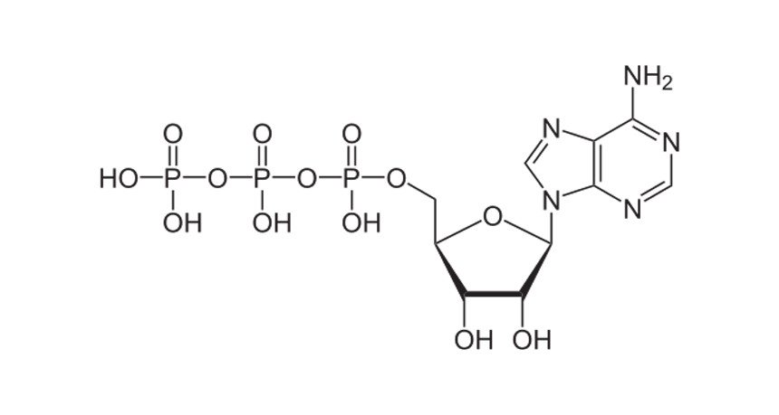
Physiology through the metabolomics lens
Animals exposed to different conditions
Identify all metabolites
Infer activity of pathways
Guanine
BIOSIGNALING
PATHWAYS
Tryptophan
NUCLEIC ACID METABOLISM
ENERGY
METABOLISM
Glucose
Fatty Acids
CARBOHYDRATE METABOLISM
Norm pH
Norm O₂
ATP
AMINO ACID METABOLISM
Low O₂
Low pH
Low pH
Low O₂
LIPID
METABOLISM
VITAMIN
METABOLISM
Notes:
We performed metabolomics analysis on a number of individual pteropods from different groups at the end of the experiment to get a comprehensive look at the presence and abundance of all metabolites. Based on that we can infer what biochemical and physiological pathways were active in the different conditions.

Slide 11
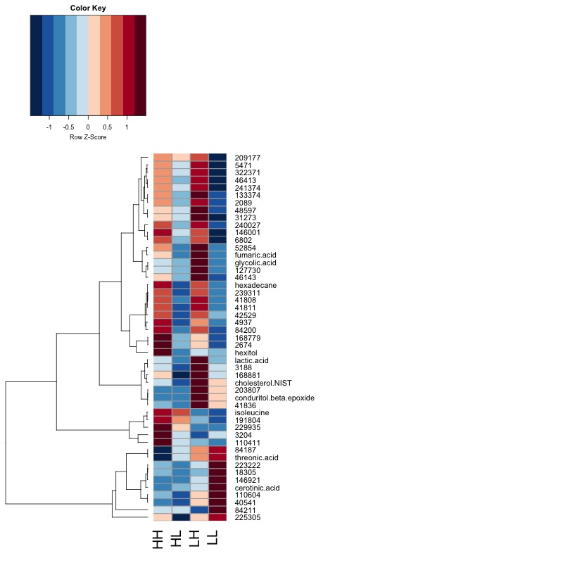
Metabolite abundances vary with conditions
Average metabolite abundance
Norm pH + O₂
Low pH + O₂
Low O₂
Low pH
abundance
low
high
Low O₂
Low
pH + O₂
Low O₂ more strongly affects metabolite abundance
↓
↓
Low pH
↓
Low pH
↓
Low pH + O₂
↓
Notes:
We found metabolite abundances vary with condition. Here we are looking at a heatmap of average metabolite abundance for each group (columns). Each row represents a different metabolite and if the box is red it means high abundance, blue means low abundance. Now if we look at this group of metabolites it shows decreased abundance in low o2 conditions, where this group shows increased abundance in response to low pH. Overall and as you can see we found low oxygen has a stronger influence on metabolite abundance than pH

Slide 12
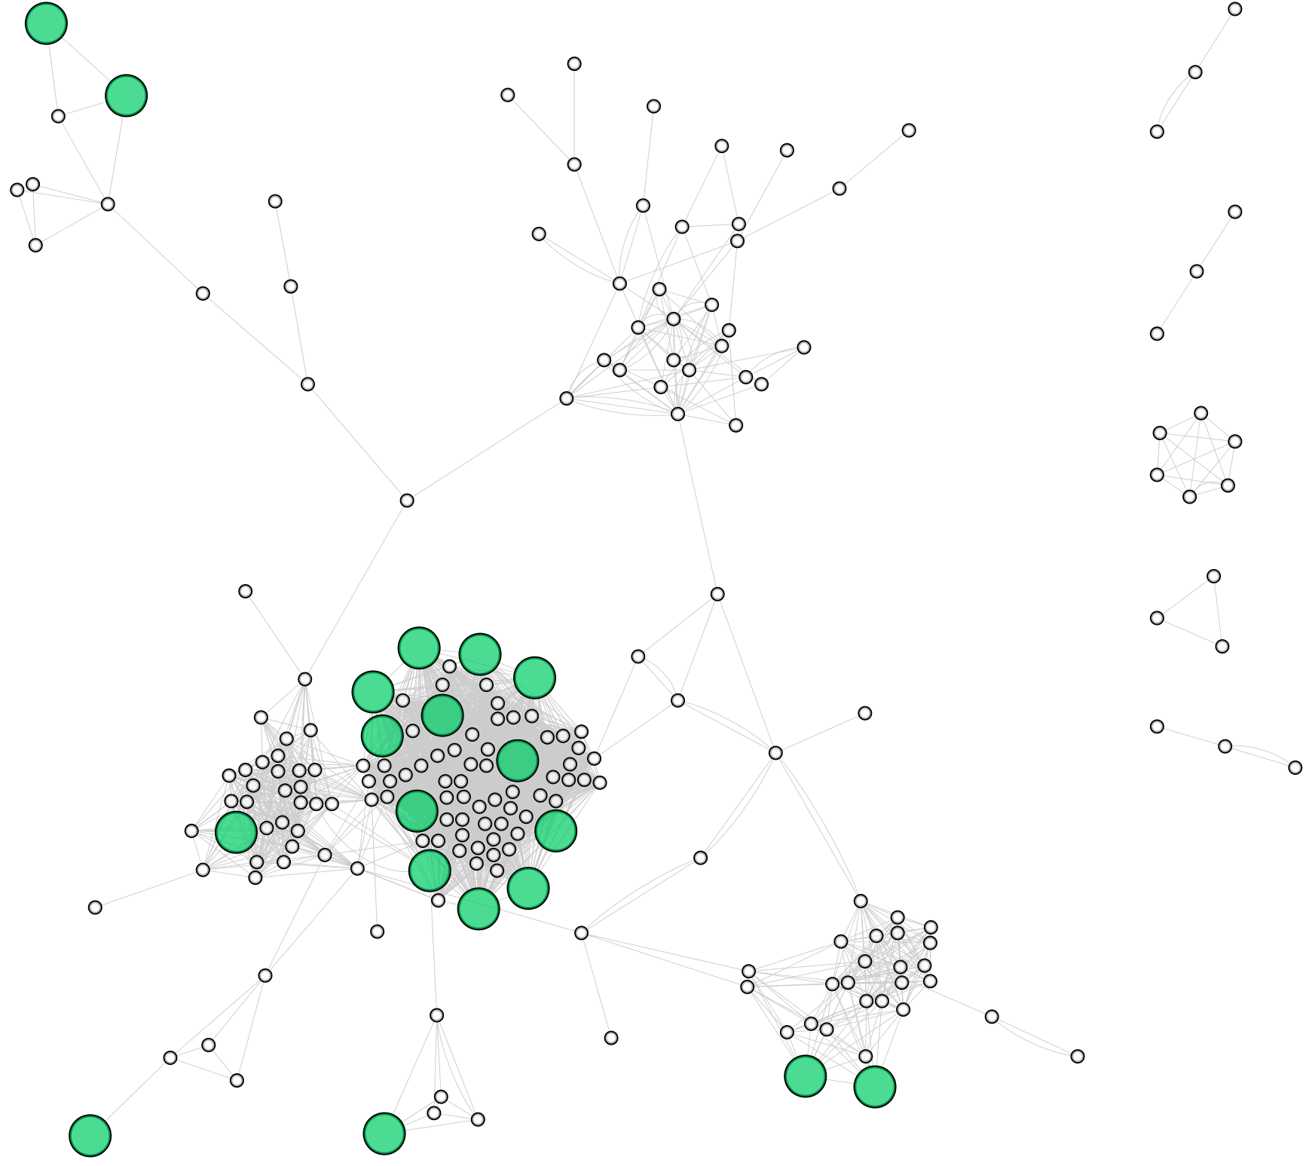
Specific compounds are affected
circles = metabolites
lines = shared pathway
cluster = chemical similarity
big and green = significantly different
Notes:
Another way to look at the data is through networks that incorporate biochemical information. Here we are looking at a bunch of circles connected by lines where the circles are different metabolites and the lines represent a shared biochemical pathway. They are clustered by chemical similarity and if the circle is big and green, it means that metabolite was significantly different across treatments by ANOVA.

Slide 13
Specific compounds are affected
α-hydroxy acids
amino acids
circles = metabolites
lines = shared pathway
cluster = chemical similarity
big and green = significantly different
sterols
lipids
sugars
Notes:
You can see that in particular this lipids shows the most number of significantly changed compounds

Slide 14
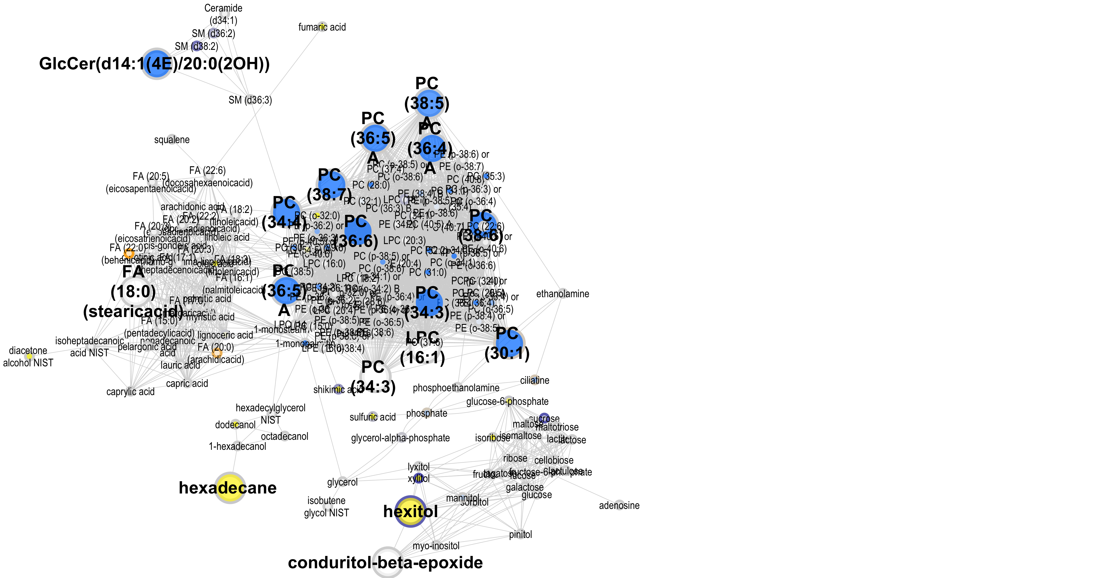
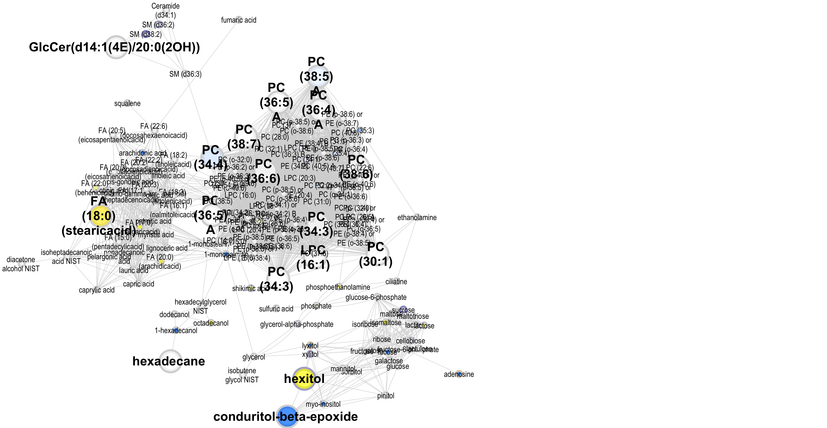

Phosphotidylcholines are significantly affected by low O₂
Low O₂
Low pH
Low pH + O₂
Notes:
Here we are looking at the same network focused on lipids, but now colored according to abundance in a treatment group relative to ambient. Blue means decreased abundance and yellow means increased abundance. We can see the same metabolites, phosphotidylcholines, are decreased in the two treatment groups that have low oxygen indicating this is an oxygen response that is dominant. This is interesting because phophotidylcholines are a lipid class found in membranes and Reduction of these compounds can make membranes more permeable and increase oxygen transport.

Slide 15
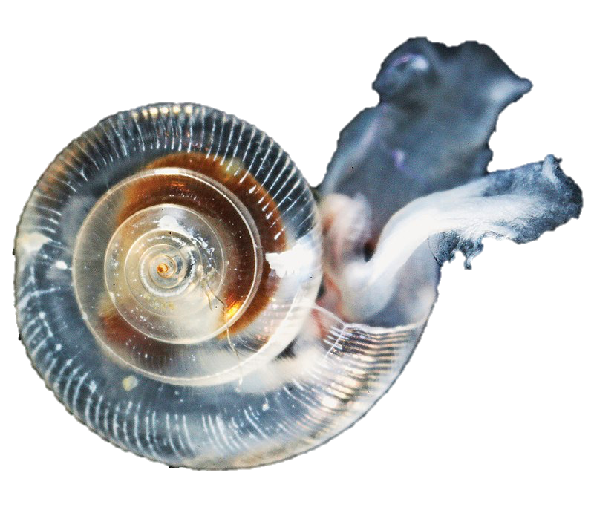
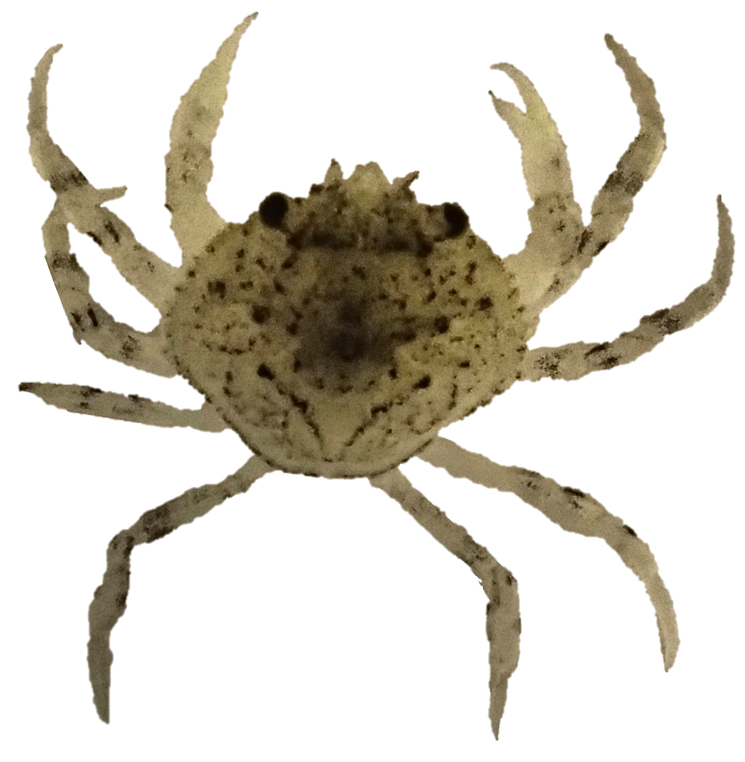
Cross-species signs of resilience in lab pH x O₂ metabolomics studies
pH x O₂ effect on survival
pH x O₂ effect on metabolome
Duration
(days)
Physiology affected
Animal
Pteropod
PC lipid metabolism
Juveniles
No significant difference
O₂ has a stronger effect
9
Dungeness crab
Amino acid metabolism
Larvae/juveniles
No significant difference
O₂ has a stronger effect
~30
Trigg et al (2019) Sci Reports
Notes:
I’m now going to summarize results from this study and a similar study in D. crab we published last year.

Slide 16
Summary
Both species show resilience to low pH and O₂ stress in the lab
Metabolomes respond to low pH and O₂
O₂ has a more wide-spread, dominant effect on metabolites
Species employ different physiological mechanisms to achieve resilience
We don’t know the longer term term consequences of these physiological compensations
Can physiological responses be sustained without compromising?

